Slide 1
Enhanced Mobility of seniors and individuals with disabilities (Section 5310)

Slide 2
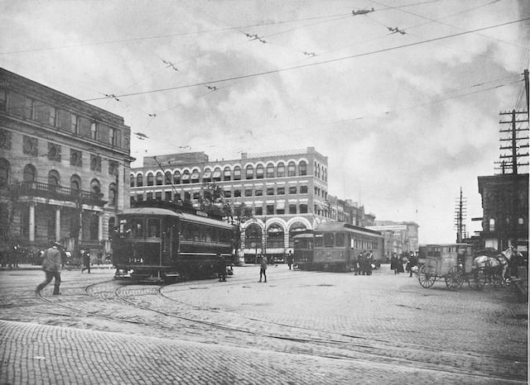
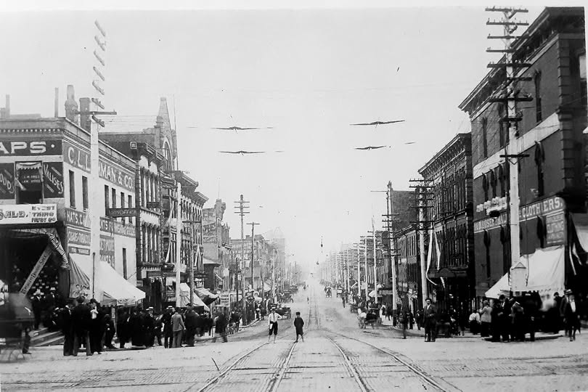
Transportation as a public service and civil access issue
Notes:
Transportation is a foundational public service that enables access to essential destinations like healthcare, employment, education and social and civic participation. A lack of mobility functions as a barrier to equal access. Transportation is not merely a convenience; it is enabling services that determines whether individuals can access opportunities and services guaranteed under law. When transportation is unavailable or inaccessible, it effectively limits participation in community life and can create systemic inequities

Slide 3
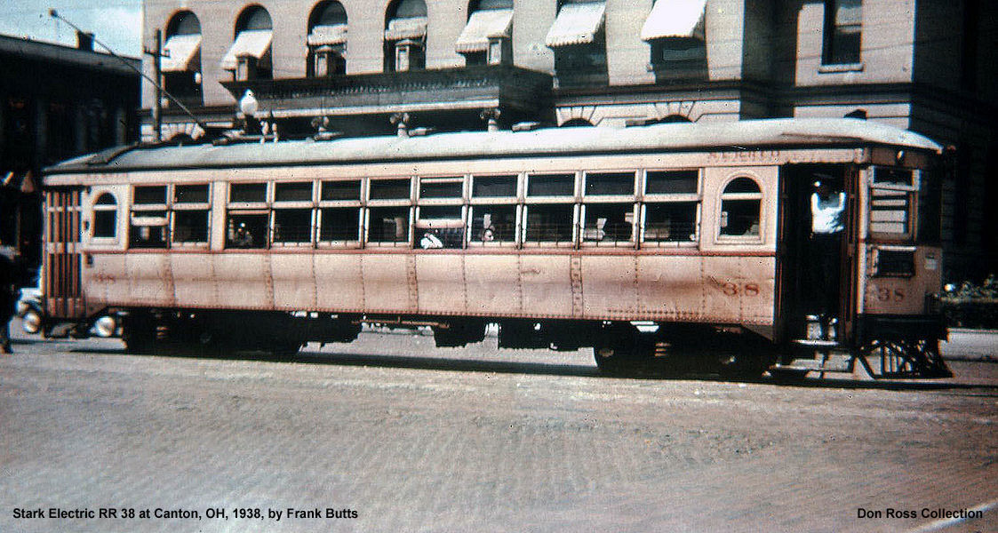
HISTORY OF movement IN STARK COUNTY
Notes:
Founded in 1805 by Bezaleel Wells, Canton was the first community to be settled in Stark County and is the county seat. The city initially spurned canal and railroad developers. Cantonians did not want the Ohio and Erie Canal, which linked Cleveland and the Ohio River port of Marietta, because they feared that standing water would be a source of disease. They refused to pledge financial support to the Cleveland and Pittsburgh Railroad (C&P) because they believed the railroad would build through Canton anyway. Instead, the C&P built 18 miles to the east, prompting the later founding of Alliance on September 26, 1850.
In the early 1900s, most cities with a population of 10,000 or more had an interurban streetcar service, the cars were powered by overhead electric lines. Ohio, Indiana, Michigan, New York and Wisconsin had half the nations electric traction miles. Ohio had 3,000 miles of these railways.

Slide 4
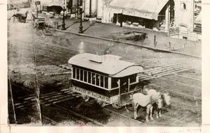
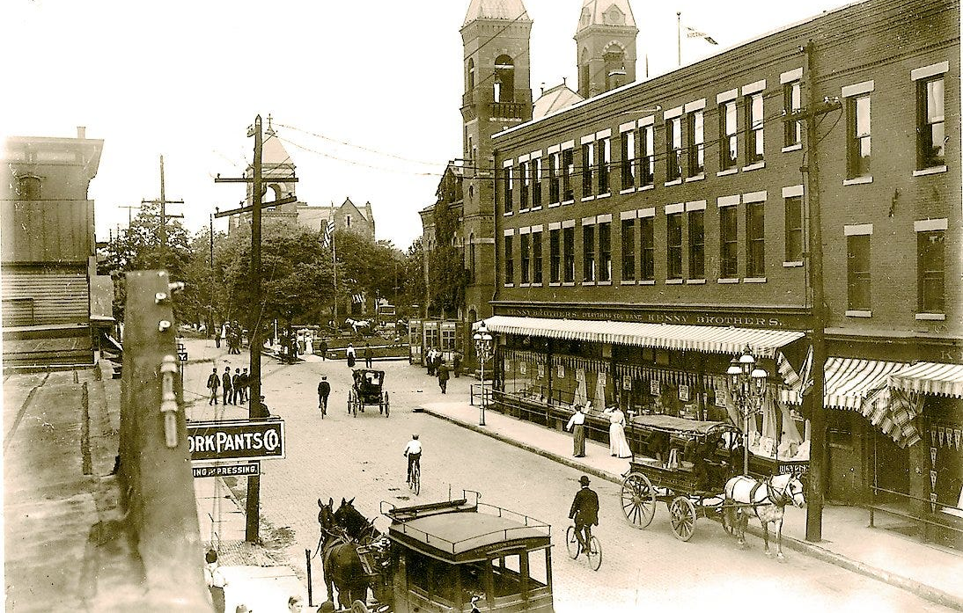
Canton Street Railway - 1884
Began with horse-drawn cars traveling four routes radiating from public square, a fifth route began in 1885
Electrified in 1890

Slide 5
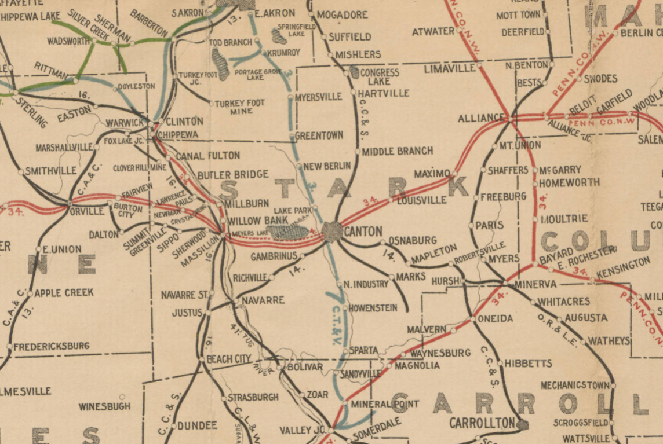
History of Transit in Stark County
Railroad Map of Stark County 1898
Canton Street Railway Company – 1884
Alliance Railway & Light Company - 1888
Canton & Massillon Electric Railway – 1892
Canton-Akron Railway - 1901
Stark Electric Railroad - 1902
Notes:
The city of Alliance approved a franchise for the Alliance Street Railway on July 31, 1888. The system began with horsecars but had given way to electrified operation four months later in early 1889. Streetcar service started in 1888 in Dover and New Philadelphia.
Canton’s first interurban railway, the Canton and Massillon Electric Railway, began service on July 2, 1892, between its namesake cities.
The Stark Electric Railroad formed in 1902, soon purchased the Alliance streetcar company, and began Canton–Alliance service on May 1, 1903. A one-way trip took 40 minutes and cost 35¢. Service was extended to Beloit on January 11, 1904, and to Salem on August 19, 1904.
The Canton-Akron Railway (CAR), formed on April 4, 1901, began Canton–Akron service on May 16, 1902, connecting in Akron with Northern Ohio Traction and Light Company (NOTL)
Service between Dover and Urichsville, and Massillon and Navarre, had begun in 1896, and the gap between Navarre and New Philadelphia was bridged in August 1902. In 1906, the CAR acquired all the interurban railways in Stark and Tuscarawas Counties except the Stark Electric. Consequently, the Canton-Akron Consolidated Railway merged with NOTL

Slide 6
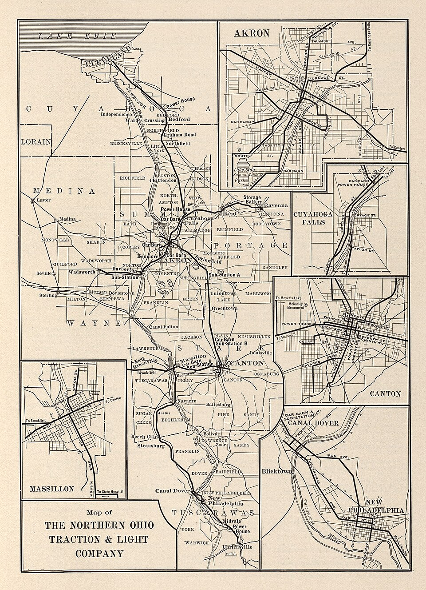
Northern Ohio Traction & Light
Bedford & Cleveland RR merged with several interurban rail lines to form this company, including the Canton-Akron Railway and Canton & Massillon Electric Railway
Notes:
NOTL founded Canton’s Meyers Lake amusement park. The Pennsylvania Railroad (PRR) operated excursion trains to Canton with park-bound patrons coming from as far away as Pittsburgh. During peak periods, NOTL cars ran to the park every three minutes.
Meyers Lake was sold in 1922 to the Sinclair family and continued to operate long after streetcar service had ended.
Interurban railways, with their lower fares and higher frequency of service, provided tough competition for steam railroads for short-distance travel. Interurban cars would stop at almost any crossroads in the countryside, thus providing rural residents a degree of mobility they had never had. Aside from providing transportation, interurban railways also employed thousands.

Slide 7
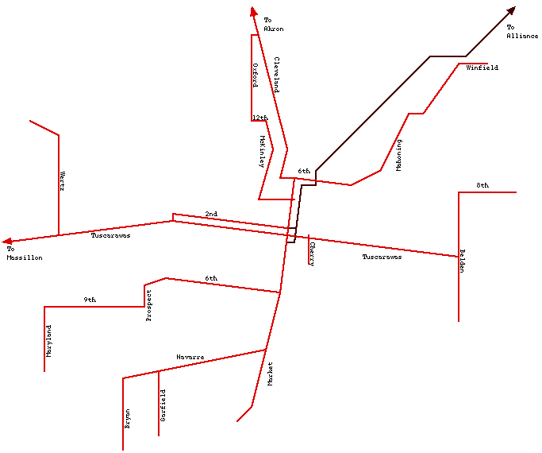
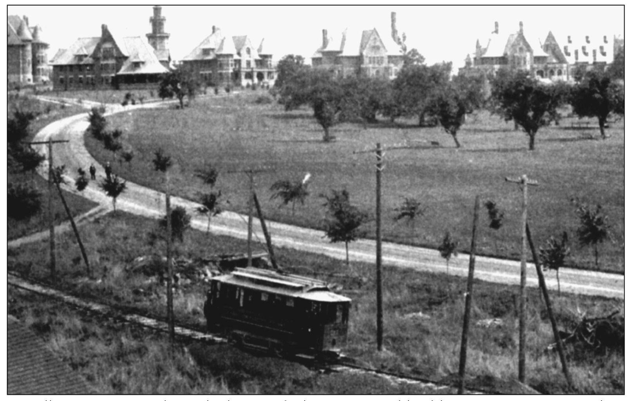
Notes:
Massillon State Hospital was the largest of Ohio’s 20 mental health institutions. Organized on March 31, 1892, it accepted its first patients on September 6, 1898. Located on the interurban railway line to Urichsville, the hospital also was served by Massillon city cars, one of which is shown here. Interurban service between Massillon and Urichsville operated for the last time on May 31, 1929.

Slide 8
Stark Electric Railway
Notes:
The CAR had 15 miles of city lines in Canton and Massillon. Buses began siphoning away riders in 1918, and eight bus lines operated in the Canton area by 1924. Massillon streetcar service operated for the final time on June 2, 1929, but Canton–Massillon interurban cars made local stops on routes they had shared with streetcars.
The Stark Electric Railroad linked Canton and Salem via Louisville, Alliance, Sebring, Damascus, and Beloit. It advertised 24-hour service and a $1 day pass that allowed unlimited travel. During daytime hours, the Stark Electric operated two round-trips an hour between Canton and Salem and four round-trips an hour between Canton and Alliance.
Headquartered in Alliance, unlike most Ohio interurban railways, the Stark Electric enjoyed growing patronage in the 1920s, peaking in 1929. When the Stark Electric operated for the final time on July 16, 1939, there were just 150 miles of interurban railways left in Ohio.
Electric railways played a major role in the migration of people from the centers of cities to undeveloped areas on the outskirts. Many middle-class workers held jobs in or near the city center, thus streetcars enabled them to commute to work. These interurban rail companies demonstrated the importance of mobility in supporting development, connecting communities and providing access to opportunity.
By the 1950s trucks had siphoned away freight, while passengers increasingly favored air travel for long distances or their own vehicles for intercity travel. Major RR companies like Pennsylvania Railroad had to contend with enormous passenger deficits, high taxes, transportation policies favoring highway and airway development, stubborn labor unions and government regulator loath to permit abandonment of lightly used passenger trains and branch lines.

Slide 9
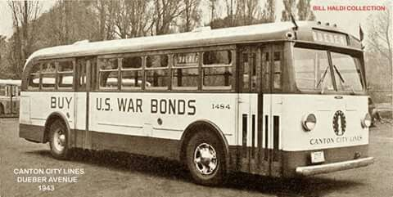
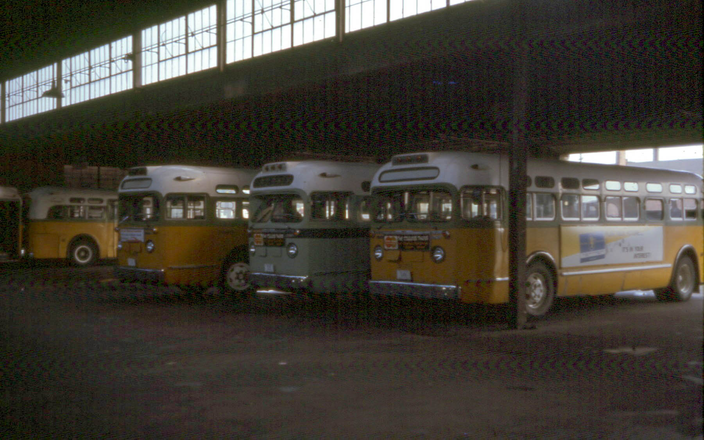
Transition from Rail to Bus Systems
RAILROAD TRAVEL BECOMING NICHE
Interurban railways, included Stark Electric Railway ceased operation by 1939
RR Ownership focused on raw material & product freight
Urban Mass Transpiration Act 1964
Rail Passenger Service Act 1970
Amtrak inception in 1971
RISE OF AUTOMOBILE OWNERSHIP & PRIVATE BUS COMPANIES
Increased car ownership after WWII
Buses offered flexible routes and lower operating costs
Canton City Lines (National City Lines)
1940-1971
Canton Regional Transit Authority
1971-1997
Stark Area Regional Transit Authority (SARTA)
Est. 1997
Privately Operated
Publicly Operated
Publicly Operated
Notes:
By the late 1930s the electric interurban railways started to shrink, automobile ownership increased significantly during the 1920s and 1930s. Cars gave people freedom to travel when and where they wanted without relying on fixed rail schedules. Road infrastructure improved dramatically, investments in paved roads made automobiles and bus travel faster than before. The Great Depression placed severe financial strain on electric railway companies making it difficult to maintain infrastructure and remain profitable.
Intercity passenger rail service continued to operate by regional enterprises throughout the United States, which saw an increase of passengers during WWII with fuel and tire rationing. However, after WWII ended, automobile ownership increased rapidly. Economic growth, suburban development, and the construction of the federal interstate highway system in the 1950s and 1960s made car ownership the primary mode of transportation.
The causes of rail travel decline is largely due to the construction of the National Highway System and airports, which were both funded by the government and competed directly with railroads. But unlike these new airline, bus and trucking companies, RR business must pay for their own infrastructure. In the 1950s passenger service route miles fell from 107,000 miles to 49,000 miles in the1960s. In 1970 Congress passed the Rail Passenger Service Act that sought government funding to ensure the continuation of passenger train operations.
Amtrak’s inception in 1971, dramatically reduced intercity rail passenger service in northeast Ohio. They initially kept four pairs of Penn Central passenger trains on the form Pennsylvania RR route through Canton, but chose not to serve Wooster, Massillon, Alliance and Salem. In the 1980’s four daily Amtrak trains stopped in Canton along the Chicago, New York and Washington D.C. line. In the 1990’s the route was diverted to stop at Alliance station.
Canton City Lines was formed in 1940 as a privately owned transit company and was part of a larger national transit holding company called National City Lines. NCL purchased and operated dozens of cities transit operations across the United States, their business model backed by General Motors and other automotive conglomerates. After WWII ridership began declining due to automobile ownership and urban sprawl. By the late 1960s and early 1970s private transit companies could no longer sustain operations. The Urban Mass Transportation Act marked the transition from private transit to publicly owned transit. In 1997 Canton Regional Transit Authority renamed itself to Stark Area Regional Transit Authority.

Slide 10
Federal Transit Administration (FTA)
1964 – Mass Transportation Act
  Created the first federal transit funding program
1968 – Urban Mass Transportation Administration
  Transit programs become part of the U.S. Department of Transportation
1970 – Federal Law established Elderly & Handicapped Program (Section 5310)
  First federal law establishing what we now call the Enhanced Mobility Program for Seniors and Individuals with Disabilities
1974 – Federal law established first formula for Urbanized Area Grant Program (5307)
1978 – Federal law established formula grants for Rural Areas (5311)
1990 – The American with Disabilities Act (ADA)
1991 – UMTA renamed FTA
Notes:
The modern era of public transportation funding really begins in 1964 with the passage of the Urban Mass Transportation Act.
This was the first time the federal government made a significant financial commitment to public transit. Prior to this, transit systems were almost entirely funded and operated at the local or private level. However, declining ridership, rising costs, and increasing automobile ownership created financial challenges for transit agencies across the country. The 1964 Act established the first federal transit funding program to help communities maintain and improve public transportation.
In 1968, transit programs were formally placed within the U.S. Department of Transportation under a new agency called the Urban Mass Transportation Administration, which is now known as the Federal Transit Administration. This created a dedicated federal entity responsible for administering transit funding and supporting transit systems nationwide.
In 1970, Congress established the Elderly and Handicapped Program, which is especially important to what we’re discussing today. This was the first federal program specifically designed to improve transportation for older adults and individuals with disabilities. This program eventually evolved into what we now know as the Section 5310 Enhanced Mobility of Seniors and Individuals with Disabilities Program. This marked a major shift in federal policy — recognizing that mobility is essential for independence, healthcare access, and quality of life.
In 1974, the federal government created the first formula-based funding program for urban transit systems, which is known today as the Section 5307 Urbanized Area Formula Program. This program provides annual funding to urban transit agencies, including systems like SARTA here in Stark County, to support capital investments and operating needs.
Then in 1978, a similar formula program was created for rural communities, known as Section 5311. This ensured that residents outside major urban areas could also benefit from federal transit support.
A major milestone came in 1990 with the passage of the Americans with Disabilities Act, or ADA. This civil rights law required transit systems to become accessible and to provide paratransit services for individuals who could not use traditional fixed-route transit. The ADA fundamentally reshaped public transit by making accessibility a legal requirement, not just a goal.
Finally, in 1991, the Urban Mass Transportation Administration was officially renamed the Federal Transit Administration. The FTA continues today as the federal agency responsible for administering transit funding programs, including Section 5310.

Slide 11

Section 5310 Enhanced Mobility of Seniors and Individuals with Disabilities
This competitive grant programs supports projects that:
Are planned, designed, and carried out to meet the special needs of seniors and individuals with disabilities when public transportation is insufficient, inappropriate, or unavailable;
Exceed the Americans with Disabilities Act (ADA) requirements:
Improve Access to fixed-route services and decrease reliance on paratransit services; and
Provide alternatives to public transportation services that assist individuals with their transportation needs
Notes:
All of these federal actions created the foundation for programs Section 5310, which today provide critical funding to support specialized transportation services here in Stark County — helping ensure that seniors and individuals with disabilities can remain connected to their communities.
Section 5310 is a competitive grant program administered by the Federal Transit Administration. Its purpose is very targeted — it supports projects that improve mobility for seniors and individuals with disabilities when traditional public transportation does not fully meet their needs.
The first key component is that projects must be planned, designed, and carried out specifically to meet the special transportation needs of seniors and individuals with disabilities. This applies in situations where public transportation may be insufficient, inappropriate, or unavailable.
In practical terms, this could mean:
Rural areas where fixed-route service does not exist,
Situations where route schedules do not align with medical appointments,
Or when an individual’s mobility needs require specialized vehicles or door-to-door service
Second, projects funded under Section 5310 are intended to exceed the minimum requirements of the Americans with Disabilities Act. ADA compliance is the legal baseline. Section 5310 goes beyond compliance — it supports enhanced services, expanded capacity, and innovative mobility solutions.
Third, the program supports projects that improve access to fixed-route services and decrease reliance on paratransit. The goal is not to replace traditional transit, but to better integrate mobility options. This might include travel training, first-mile/last-mile solutions, or coordination efforts that help individuals use the broader transit network more effectively.
Finally, Section 5310 funds can be used to provide alternatives to public transportation services. This can include vehicle purchases for nonprofit agencies, coordinated transportation services, mobility management, and other strategies that address gaps in the system.
Here in Stark County, this program plays a critical role in ensuring that transportation is not a barrier to healthcare, employment, nutrition services, or community participation. It allows us to strategically invest in projects that directly improve quality of life for some of our most transportation-dependent residents.

Slide 12
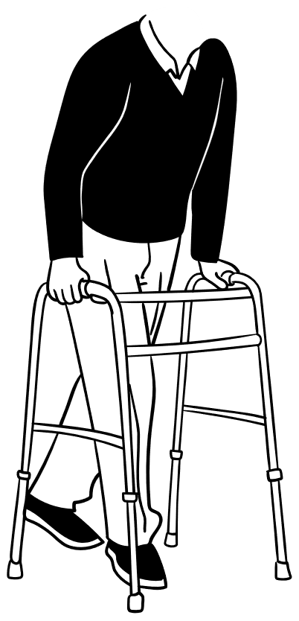

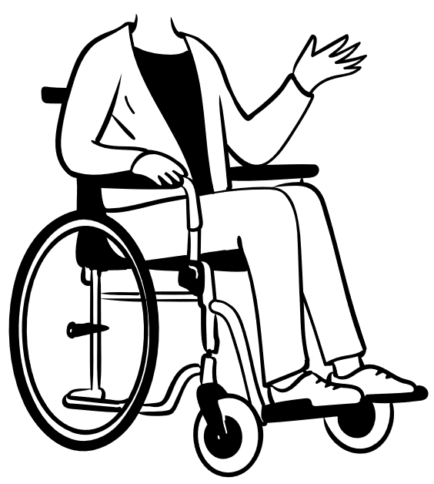
Section 5310 Enhanced Mobility of Seniors and Individuals with Disabilities
Eligible Applicants
State or local government authority, private & public non-profit & for-profit agencies
All awardees must meet federal requirements which include:
  Support transportation services to seniors and/or individuals with disabilities
  Service the Canton-Massillon Urban Area
  Certify and cooperating with all FTA certifications & assurances, and reporting requirements
Eligible Projects
Funds support Traditional Capital & Other Capital and Operating projects that improve transportation for seniors and individuals with disabilities
Notes:
First, in terms of eligible applicants — the program is open to state or local government authorities, as well as private and public nonprofit organizations. In certain circumstances, for-profit agencies that provide transportation services may also apply. However, eligibility to apply does not automatically mean eligibility to receive funding. All awardees must comply with federal requirements established by the Federal Transit Administration.
That includes demonstrating that the project supports transportation services specifically for seniors and/or individuals with disabilities. The service area must be within the Canton–Massillon Urban Area. Applicants must also certify compliance with all FTA certifications and assurances, including civil rights requirements, procurement standards, drug and alcohol testing if applicable, and ongoing federal reporting obligations.
In terms of eligible projects, Section 5310 funds both Traditional Capital projects and Other Capital and Operating projects.
Traditional Capital projects typically include vehicle purchases and major equipment that directly provides transportation service.
Other Capital and Operating projects can include mobility management, travel training, technology improvements, or other service enhancements that improve access and coordination.
In all cases, the project must clearly demonstrate how it improves mobility for seniors and individuals with disabilities and addresses a documented need within our service area.”

Slide 13



Traditional Capital Projects
80% Federal / 20% Local Match
Eligible Vehicle Expenses
Purchase of accessible vans and buses
Vehicle replacement, rehabilitation, and preventive maintenance
Wheelchair lifts, ramps and securement equipment
Radios and communication systems
Support Equipment & Technology
Dispatch systems
Scheduling software and hardware
Extended vehicle warranties
Mobility Management
Coordination between transportation providers
One-call centers, travel training and service coordination
ADA Paratransit Support
Vehicles and capital equipment supporting ADA complementary paratransit services
ODOT Vehicle Catalog & Selection Guide
Traditional Capital Projects total applicant/subrecipient funding request may not exceed $125,000
Notes:
Traditional Capital funding is primarily used for the purchase of vehicles and vehicle-related equipment that directly support transportation services for seniors and individuals with disabilities.
In most cases, this means accessible vehicles — such as lift- or ramp-equipped vans and small buses — that are used to provide demand-response or specialized transportation service.
Under this category, the federal share is 80 percent of the total project cost, with a required 20 percent local match. The local match must come from eligible non-federal sources and cannot include other U.S. Department of Transportation funds.
There is currently a funding cap of $125,000 per applicant for Traditional Capital requests. This helps ensure that funding is distributed equitably among qualified applicants within the urbanized area.
Additionally, all vehicle purchases must align with the Ohio Department of Transportation’s approved vehicle catalog and selection guidance. This ensures compliance with state and federal procurement standards, as well as consistency in fleet management.
It’s important to emphasize that while vehicle acquisition is the most common Traditional Capital request, applicants must still clearly demonstrate need, service plan, and coordination with existing providers. Simply replacing or purchasing a vehicle is not sufficient without documenting how it improves mobility outcomes for the target population.

Slide 14
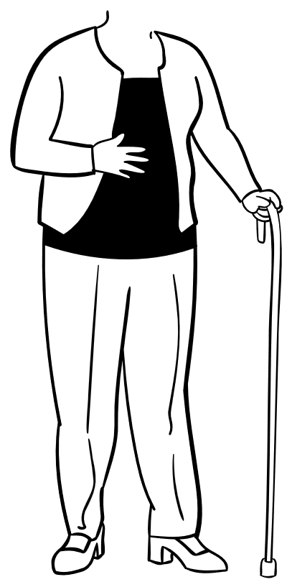
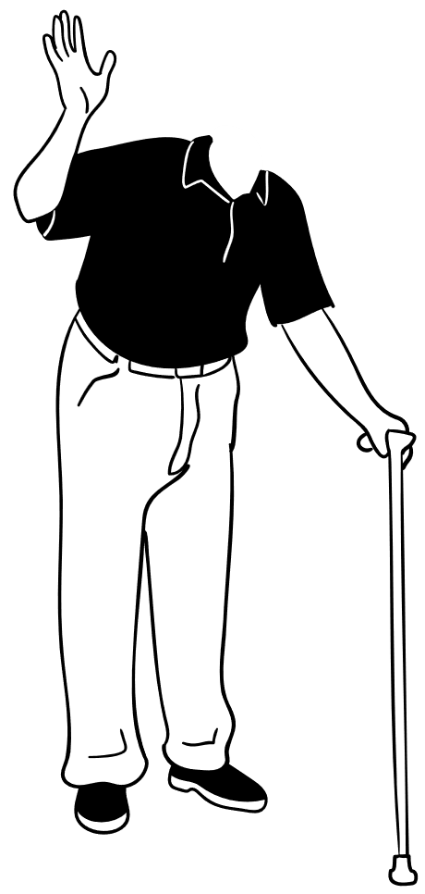
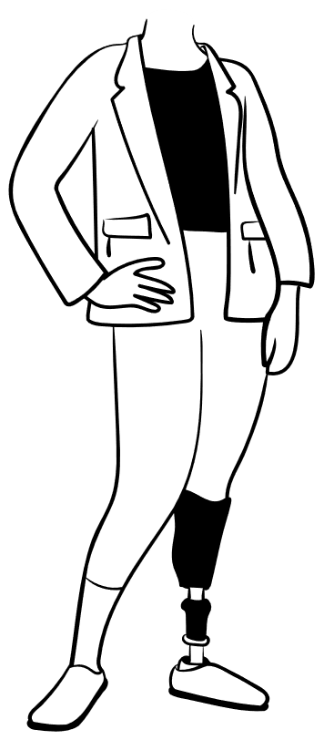
Other Capital & Operating Projects
50% Federal / 50% Local Match
Purpose
Support transportation that goes beyond ADA minimum requirements
Provides new or expanded mobility options for seniors and individuals with disabilities
Eligible Project Examples
Expanded paratransits service areas or hours
Same-day or door-to-door service enhancements
Escort or rider assistance programs
Vehicles and equipment for larger or specialized mobility devices
Not Eligible
Operating assistance for ADA-required paratransit
Transit passes or vouchers for existing fixed-route
Other Capital & Operating Projects total applicant/subrecipient funding request may not exceed $125,000
Requests for equipment that support programs are limited to no more than $60,000
Notes:
While Traditional Capital projects focus primarily on vehicles and equipment, this category supports projects that expand or enhance transportation services beyond basic requirements.
These projects are funded at a 50 percent federal share and require a 50 percent local match. As with all Section 5310 funding, the local match must come from eligible non-U.S. DOT sources.
Other Capital and Operating projects are intended to go beyond the minimum standards required under the Americans with Disabilities Act. In other words, ADA compliance is the baseline — this funding supports improvements that enhance mobility access above and beyond that baseline.
Examples may include:
Expanded service hours or service areas
Same-day service enhancements
Mobility management initiatives
Travel training programs
Coordination technology
Or specialized services that fill documented gaps
These projects are particularly valuable because they allow communities to address service inefficiencies, improve coordination among providers, and create more flexible mobility options.
As with Traditional Capital projects, there is a funding cap of $125,000 per applicant, and equipment-only requests are limited to $60,000. Ultimately, the key evaluation factor is whether the project clearly improves mobility for seniors and individuals with disabilities and aligns with the priorities identified in the Coordinated Transportation Plan.

Slide 15




Local Match Sources
State or local appropriations
Dedicated tax revenues
Private donations
Revenue from human service contracts
New income generated from advertising
Non-DOT Federal Funds
Local match cannot be U.S. Department of Transportation Funds
Notes:
As a reminder, Section 5310 is not a 100 percent federal funding program. Every award requires a local match — typically 20 percent for Traditional Capital projects and 50 percent for Other Capital and Operating projects.
The local share must come from non-U.S. DOT sources. That means federal transportation funds cannot be used as match.
Eligible local match sources may include:
Local government funds, such as county, municipal, or township appropriations
Agency general funds
State grant funds that are not derived from U.S. DOT
Private foundation grants
Donations or contributions
Contract revenue from human service agencies
In some cases, in-kind contributions, if they are properly documented and allowable under federal cost principles
It is critical that applicants clearly identify and document their match source at the time of application. The match must be committed, eligible, and auditable.
From an evaluation standpoint, projects with stable and clearly defined local funding commitments are viewed more favorably because they demonstrate financial capacity and long-term sustainability.
Ultimately, the local match requirement ensures shared investment and accountability in improving mobility for seniors and individuals with disabilities.

Slide 16


Funding Stipulations
SARTA and SCATS are jointly the Designated Recipient of Federal Transit Administration (FTA) Section 5310 funds of the Canton-Massillon Urban Area
Awardees are subrecipients of funds unless they are an eligible direct recipient (public transit agencies)
Subrecipient awards are on a reimbursement basis:
  Subrecipient initially incurs 100% of cost
  Subrecipient provides invoice(s)/documentation to SARTA
  SARTA reimburses the subrecipient upon approval
Notes:
First, within the Canton–Massillon Urbanized Area, SARTA and SCATS jointly serve as the Designated Recipient of Federal Transit Administration Section 5310 funds. That means they are responsible to the FTA for program oversight, compliance, and reporting.
Most organizations that receive funding through this program are considered subrecipients. The exception would be eligible direct recipients, such as public transit agencies, that may receive funds directly under certain circumstances.
It is important to understand that all subrecipient awards operate on a reimbursement basis. This is not an advance payment program.
The process works as follows:
The subrecipient initially incurs 100 percent of the project cost using its own funds.
The subrecipient then submits invoices and supporting documentation to SARTA for review.
Once the expenses are verified as eligible and compliant with federal requirements, SARTA processes reimbursement for the federal share.
Because of this structure, applicants must have sufficient cash flow to front project costs before reimbursement. Strong financial management and documentation practices are essential to remain in good standing.
In short, SARTA and SCATS oversee the program locally, subrecipients carry out the projects, and reimbursements are made after eligible expenses are incurred and approved.

Slide 17
FTA Reporting Requirement
Traditional capital projects
Service Gaps Filled
Ridership
Mileage
Number of seniors and individuals with disabilities gaining new mobility
Annual one-way passenger trips provided
Total miles traveled providing service
Other capital & operating projects
All section 5310 projects must track and report service outputs and outcomes
Service Improvements
Infrastructure & Equipment
Ridership
Expanded service area, hours, or quality
Vehicles, technology, and facility improvements
Annual one-way passenger trips provided
Notes:
All Section 5310 projects — regardless of category — must track and report measurable service outputs and outcomes. FTA requires performance data to demonstrate that federal funds are producing tangible mobility benefits for seniors and individuals with disabilities.
For Traditional Capital Projects, there are three primary reporting measures:
First, Service Gaps Filled. This measures the number of seniors and individuals with disabilities who gain mobility that would not otherwise be available without the funded project. It is intended to quantify how the investment expands access.
Second, Ridership. Subrecipients must report the actual or estimated annual number of one-way passenger trips provided as a result of the project.
Third, Mileage. This includes the total miles traveled annually while providing transportation service supported by the Section 5310 award.
For Other Capital and Operating Projects, reporting focuses on service enhancements and system improvements.
First, Service Improvements. This includes measurable increases in service area coverage, expanded hours of operation, improved service quality, or other enhancements that increase transportation availability.
Second, Infrastructure and Equipment Improvements. This covers capital investments such as vehicles, technology systems, dispatch software, accessibility upgrades, or facility improvements that enhance mobility access.
Third, Ridership. As with Traditional Capital projects, subrecipients must report the annual number of one-way passenger trips provided.
Accurate reporting is critical. These metrics support federal oversight, justify continued funding, and demonstrate the real-world impact of mobility investments within the Canton–Massillon Urban Area.
Strong data collection practices should be built into every project from the outset to ensure compliance and successful program performance.

Slide 18
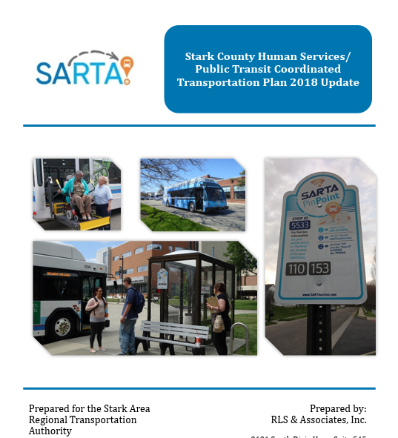
Coordinated Plan Requirement
Coordinated Transportation Plan
Notes:
Under federal law, all Section 5310 projects must be derived from a locally developed, coordinated public transit–human services transportation plan. In our region, that document is the Stark County Human Services/Public Transit Coordinated Transportation Plan.
This plan identifies unmet transportation needs for seniors and individuals with disabilities, outlines service gaps, and establishes priority strategies to improve mobility access throughout the county.
For an application to be eligible, the proposed project must clearly align with and support a need or strategy identified in the Coordinated Plan. If a project cannot demonstrate that connection, it is not eligible for funding consideration.
The purpose of this requirement is to ensure that federal funds are invested strategically — not in isolation — but as part of a coordinated regional mobility framework. It promotes collaboration among public transit providers, human service agencies, local governments, and nonprofit organizations.
In practical terms, applicants should reference specific goals, priorities, or identified gaps from the Coordinated Plan within their proposal narrative. Strong alignment strengthens both eligibility and competitiveness during evaluation.
In short, the Coordinated Plan is not just a planning document — it is the policy foundation that guides how Section 5310 funds are deployed in Stark County.

Slide 19
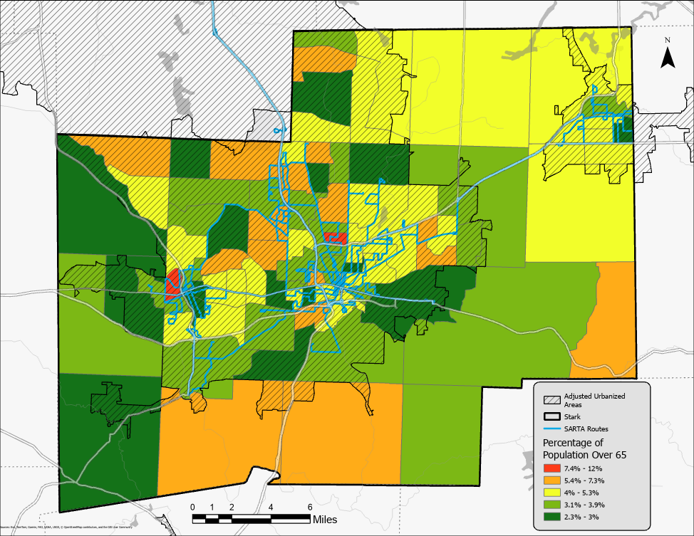
Notes:
This map illustrates the percentage of the population age 65 and older across Stark County.
We can see that older residents are distributed across both urbanized areas and several suburban and rural communities. Some townships show notably higher concentrations of seniors compared to the county average.
This is important because older adults are more likely to experience changes in driving ability, increased medical trip needs, and reliance on accessible transportation options.
From a planning standpoint, this map helps us identify where aging populations may require enhanced mobility services — whether that is demand-response service, coordinated medical transportation, or expanded fixed-route accessibility.
As Stark County’s population continues to age, these geographic patterns will be central to how we target Section 5310 investments.

Slide 20
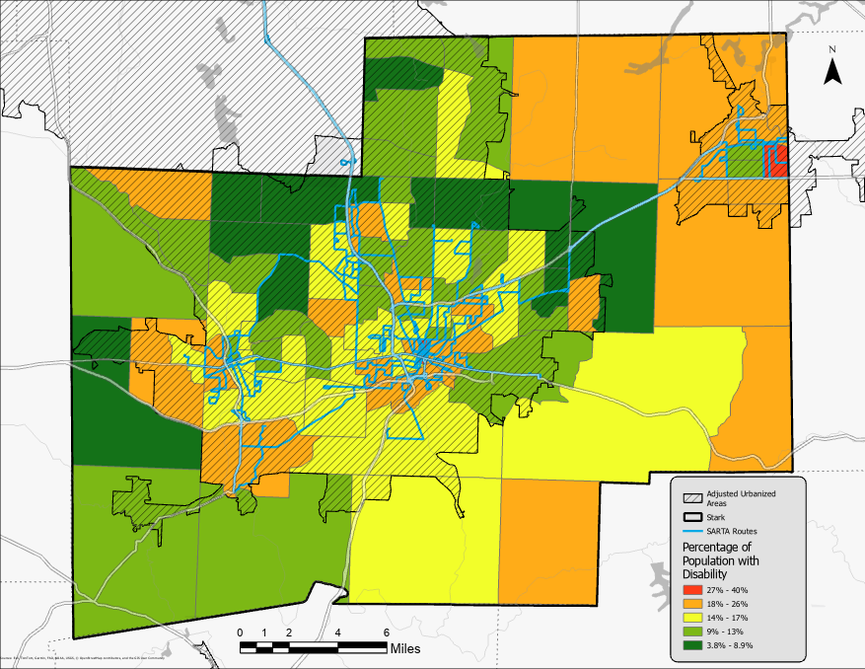
Notes:
This map shows the percentage of residents reporting a disability across Stark County.
What is important to note here is that the geographic pattern differs from the age 65 and over map. Areas with higher disability prevalence are not always the same areas with the highest senior population.
This tells us something critical from a policy perspective: mobility need is not concentrated in one single corridor or demographic cluster. Instead, it is distributed and varies by community.
Some areas may have younger populations with higher disability rates, while other areas may have larger senior populations but comparatively lower reported disability rates.
For Section 5310 planning, this means we cannot rely on age alone as a proxy for transportation need. We must evaluate both demographic factors independently.
These maps together demonstrate that:
Mobility challenges exist in multiple parts of the county,
The needs are diverse,
And transportation solutions must be flexible and geographically responsive.
This reinforces the importance of coordinated planning and targeted project selection when allocating Section 5310 funds.

Slide 21
Application Process
Applications can be found on our Mobility Coordination Committee Page
Each application is scored based on the Project Narrative, which consists of four sections totally 130 possible points
A) Scope of Work, Project Need Objectives, Coordination and Outreach (40 points)
B) Project & Management Plans, Enhanced/Expanded Project Proposal (30 points)
C) Performance Indicators and Project Effectiveness (20 points)
D) Budget Justification (40 points)
Notes:
This slide outlines the Section 5310 application process and how proposals are evaluated.
Applications are available on the Mobility Coordination Committee page. All materials, instructions, scoring criteria, and deadlines are posted there to ensure transparency and consistency.
Each application is evaluated through a formal scoring process. The primary evaluation tool is the Project Narrative, which consists of four sections totaling 130 possible points.
Section A is Scope of Work, Project Need, Objectives, Coordination, and Outreach — worth 40 points.
This section evaluates how clearly the applicant defines the transportation need, how well the project aligns with the Coordinated Plan, and the extent to which the applicant demonstrates coordination with other agencies and stakeholders.
Section B is Project and Management Plans, including any Enhanced or Expanded Project Proposal — worth 30 points.
This evaluates implementation readiness, organizational capacity, operational structure, and whether the applicant has a realistic plan to deliver the proposed service or capital investment.
Section C is Performance Indicators and Project Effectiveness — worth 20 points.
Here, reviewers assess whether the applicant has identified measurable outcomes, realistic performance targets, and a clear methodology for tracking results in accordance with FTA reporting requirements.
Section D is Budget Justification — worth 40 points.
This section evaluates financial clarity, cost reasonableness, local match identification, and whether the proposed expenses are eligible and aligned with the scope of work.
Because the highest point values are assigned to Scope of Work and Budget Justification, it is critical that applicants clearly define the transportation gap being addressed and present a well-supported financial plan.
The scoring structure is designed to prioritize projects that demonstrate documented need, readiness, coordination, fiscal responsibility, and measurable impact for seniors and individuals with disabilities.

Slide 22
Application Process – Risk Assessment
All applicants provide if available:
1. Public Entity: Your organizations most recent Financial Audit
Non-profit: Your organization’s most recent Financial Audit (will accept IRS Form 990 if no recent audit)
For-profit: Most recent applicable IRS Form tax return
Notes:
This slide outlines the risk assessment component of the application process.
In addition to the project narrative scoring, all applicants are required to submit financial documentation, if available, to support a basic fiscal risk review.
Because Section 5310 is federally funded and operates on a reimbursement basis, financial capacity and internal controls are critical. Applicants must demonstrate that they have the administrative and financial stability to manage federal funds responsibly.
The documentation requirements vary by organization type:
For public entities, we request the organization’s most recent financial audit.
For non-profit organizations, we also request the most recent financial audit. If a recent audit is not available, we will accept the organization’s IRS Form 990.
For for-profit entities, the most recent applicable IRS tax return is required.
These documents are not scored as part of the 130-point project evaluation. Instead, they are used to assess financial stability, internal controls, and overall organizational risk.
This step helps ensure that awarded funds are administered by entities with adequate fiscal oversight, accounting systems, and capacity to front project costs prior to reimbursement.
In short, the risk assessment process protects both the applicant and the program by promoting responsible stewardship of federal funds.

Slide 23
Application Process – Risk Assessment
All applicants provide if available:
2. UEI (Unique Entity Identifier): SARTA will review entity’s US Federal Government’s System Award Management (SAM) system status, and may disqualify applicants who have negative status
3. Ohio Charter Number: SARTA will review entity's status with Ohio Secretary of State and may disqualify applicants who have a negative status
Notes:
This slide covers the entity verification portion of the risk assessment process.
Beyond financial documentation, all applicants must demonstrate that their organization is properly registered and in good standing at both the federal and state levels.
First, the UEI — or Unique Entity Identifier.
All entities receiving federal funding must have an active UEI and be registered in the federal System for Award Management, commonly referred to as SAM.
SARTA will review each applicant’s SAM registration status. If an entity has an inactive registration, exclusions, or any negative standing within SAM, the application may be disqualified. Active registration is a federal requirement and must remain current throughout the award period.
Second, for organizations operating in Ohio, SARTA will verify the entity’s Ohio Charter Number and confirm good standing with the Ohio Secretary of State. If an organization’s registration is inactive, canceled, or otherwise not in good standing at the state level, that may also result in disqualification.
These verification steps ensure that awarded funds are only distributed to legally established, compliant entities authorized to conduct business and receive federal funds.
In short, maintaining active federal registration and good state standing is not optional — it is a baseline eligibility requirement for participation in the Section 5310 program.

Slide 24
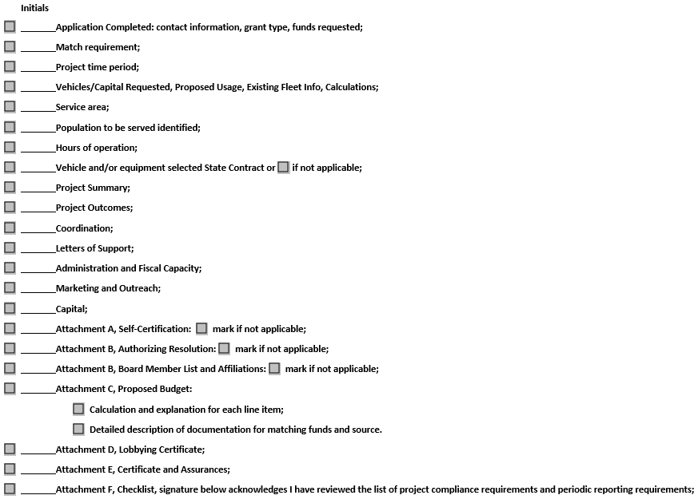
Application Process - Checklist
Intended to ensure completeness, compliance, and evaluation readiness at the time of submission
Notes:
Our application has an accompanied application checklist. This is intended to ensure completeness, compliance, and evaluation readiness at the time of submission.
First, the core application must be fully completed. That includes:
Contact information,
Grant type,
Total funds requested,
Identification of the required local match,
The proposed project time period.
If vehicles or capital are requested, applicants must provide:
Detailed vehicle or equipment information,
Proposed usage,
Existing fleet information,
And supporting calculations that justify the request.
Applicants must clearly define:
The service area,
The target population to be served,
And the proposed hours of operation.
If applicable, the selected State Contract vehicle or equipment must be identified.
The narrative components must include:
A concise project summary,
Measurable project outcomes,
Coordination efforts,
Letters of support,
Administration and fiscal capacity,
And marketing and outreach strategy.
Attachment requirements are equally important.
Attachment A is the Self-Certification, if applicable.
Attachment B includes the Authorizing Resolution and Board Member List with affiliations.
Attachment C is the Proposed Budget — including detailed line-item calculations and clear documentation of matching fund sources.
Attachment D is the Lobbying Certificate.
Attachment E includes the required Certifications and Assurances.
And Attachment F is the final compliance checklist, acknowledging review of project compliance and periodic reporting requirements.
Incomplete applications, missing attachments, or insufficient documentation may delay review or result in disqualification.
This checklist is designed to ensure that every applicant demonstrates eligibility, readiness, financial capacity, and compliance with federal and local program requirements before evaluation begins.

Slide 25
Application Process – Evaluation & Timeline
Spring 2026 – Solicitation Opens
Spring 2026 – Public Kickoff Meeting
Early Summer 2026 – Applications Due
Summer 2026 – Competitive Evaluation (SARTA & SCATS Staff)
Late Summer 2026 – Funding Recommendations & Applicant Notification
Notes:
This slide outlines the annual evaluation cycle and timeline for the Section 5310 program.
In the spring, we formally open the solicitation for proposals. Application materials are posted publicly, and eligible organizations are invited to apply.
Shortly after release, we host a public kickoff meeting. This meeting provides an overview of eligibility requirements, scoring criteria, compliance expectations, and an opportunity for applicants to ask technical questions.
Applications are then due in early summer. All submissions must be complete at the time of the deadline, including required attachments and certifications.
Following the deadline, SARTA and SCATS staff conduct a competitive evaluation process. Applications are scored based on the 130-point project narrative criteria, and risk assessments are reviewed to ensure financial and organizational capacity.
Based on the scoring results and available funding, staff identify funding recommendations.
In late summer, applicants are formally notified of award decisions.
For selected applicants, the next phase begins. Awardees work directly with SARTA to execute funding agreements, finalize project details, and ensure compliance with Federal Transit Administration requirements.
Projects operate on a reimbursement basis. Subrecipients submit invoices with required documentation, and SARTA processes reimbursement after eligibility review.
Throughout the project period, awardees must comply with all FTA program requirements, including reporting of service outputs and outcomes.
In summary, this process ensures transparency, competitiveness, fiscal accountability, and alignment with regional mobility priorities.

Slide 26
Resources
FTA Section 5310 Technical Assistance Webpage: Enhanced Mobility of Seniors & Individuals with Disabilities (Section 5310) Program Technical Assistance | FTA
ODOT Vehicle Catalog and Selection Guide: Current Vehicles and Add-on options available through cooperative purchasing program
National Aging and Disability Transportation Center: NADTC
Coordinating Council on Access and Mobility: CCAM
Notes:
This slide provides key technical assistance and reference resources for applicants and subrecipients.
First, the FTA Section 5310 Technical Assistance webpage. This is the primary federal guidance source for the Enhanced Mobility of Seniors and Individuals with Disabilities Program. It includes program circulars, FAQs, eligibility guidance, compliance requirements, and performance reporting information. Applicants should reference this site when developing proposals or managing awarded projects.
Second, the ODOT Vehicle Catalog and Selection Guide. For agencies pursuing vehicle purchases, this resource outlines current vehicles and available add-on options through the State of Ohio’s cooperative purchasing program. Using the state contract simplifies procurement and ensures compliance with federal purchasing requirements.
Third, the National Aging and Disability Transportation Center, or NADTC. NADTC provides training materials, mobility management tools, research, and best practices focused specifically on improving transportation access for older adults and individuals with disabilities.
Finally, the Coordinating Council on Access and Mobility, known as CCAM. CCAM is a federal interagency partnership that promotes coordination across transportation and human service programs. It offers policy guidance and national-level coordination strategies that can help local agencies align funding and services more effectively.
Together, these resources support compliance, strengthen applications, and improve long-term project success under the Section 5310 program.

Slide 27


THANK YOU
Spencer Gibbs
Stark County Area Transportation Study SCATS
scgibbs@starkcountyohio.gov
Christ Tyson
Stark Area Regional Transit Authority SARTA
ctyson@sartaonline.com
Notes:
And with that, I want to thank everyone for your time and attention today.
Section 5310 is an important tool for improving mobility for seniors and individuals with disabilities in the Canton–Massillon Urbanized Area. The success of this program depends on strong coordination, thoughtful project development, and committed local partners.
If you are considering applying, I strongly encourage you to begin reviewing the application materials early, confirm your eligibility status, and start identifying your local match source.
I’m available to answer questions about eligibility, project fit, documentation requirements, or the evaluation process. Early coordination often leads to stronger, more competitive applications.
Thank you again for your continued partnership in improving transportation access in Stark County.
I’m happy to take any questions

